Slide 1
Housing Price Prediction
Problem statement:
Houses are one of the necessary need of each and every person around the globe and therefore housing and real estate market
is one of the markets which is one of the major contributors in the world’s economy. It is a very large market and there are various
companies working in the domain. Data science comes as a very important tool to solve problems in the domain to help the
companies increase their overall revenue, profits, improving their marketing strategies and focusing on changing trends in house
sales and purchases. Predictive modelling, Market mix modelling, recommendation systems are some of the machine learning
techniques used for achieving the business goals for housing companies. Our problem is related to one such housing company.
A US-based housing company named Surprise Housing has decided to enter the Australian market. The company uses data
analytics to purchase houses at a price below their actual values and flip them at a higher price. For the same purpose, the
company has collected a data set from the sale of houses in Australia. The data is provided in the CSV file below.
The company is looking at prospective properties to buy houses to enter the market. You are required to build a model using
Machine Learning in order to predict the actual value of the prospective properties and decide whether to invest in them or not.
For this company wants to know:
Which variables are important to predict the price of variable?
How do these variables describe the price of the house?
Business Goal:
You are required to model the price of houses with the available independent variables. This model will then be used by the
management to understand how exactly the prices vary with the variables. They can accordingly manipulate the strategy of the
firm and concentrate on areas that will yield high returns. Further, the model will be a good way for the management to
understand the pricing dynamics of a new market.

Slide 2
EDA Steps and Visualization
1- Finding null values and removing it.
2- Describing dataset.
3- Finding Correlation of the dataset.
4-Importing Seaborn and doing the visualization to get the insights of the dataset.
5- Using Countplot and Histplot, we got the insights of the dataset.
6- Finding the outliers using skew skew method and box plot for visualization.
7- Removing the outliers using zscore or IQR method.
8- Separating x and y or into features and label.
9- Transforming the data using Power Transform.
10- Scaling the data as ML works best in scaled data.

Slide 3
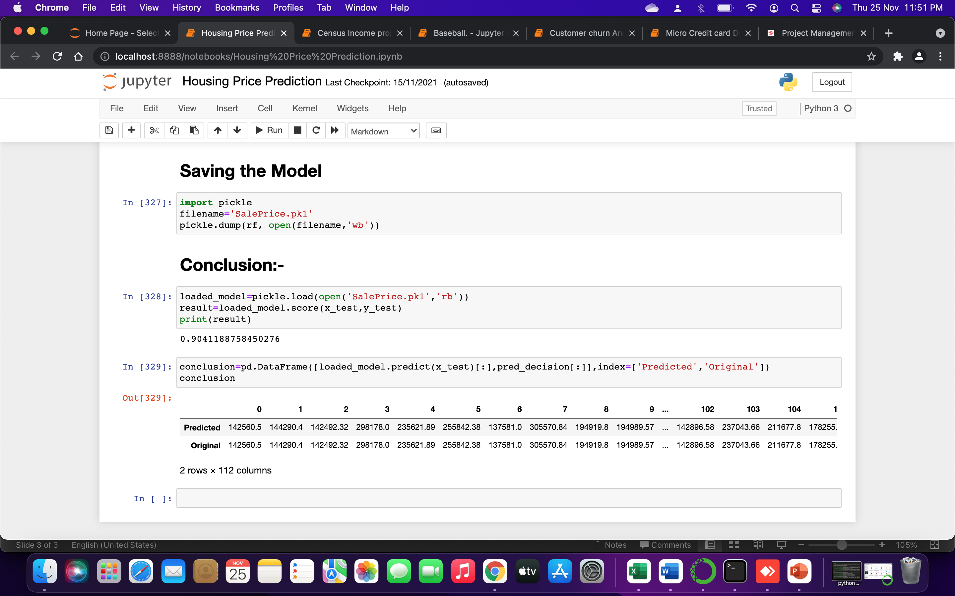
Conclusion

